Slide 1


<Dang Phuoc Hung>
<February 24,2026>

Slide 2

Outline
Executive Summary
Introduction
Methodology
Results
Conclusion
Appendix

Slide 3
Executive Summary
In this capstone project, we aim to predict whether the SpaceX Falcon 9 first stage will successfully land by applying various machine learning classification models.
The project workflow includes data collection and preprocessing, exploratory data analysis, interactive data visualization, and predictive modeling.
Through data analysis, we observe that certain launch features, such as payload, orbit, and launch site are associated with mission outcomes(success or failure).
Among the models evaluated, the Decision Tree algorithm demonstrated the best performance in predicting first stage landing success.

Slide 4
Introduction
In this capstone project, we aim to predict whether the Falcon 9 first stage will land successfully. SpaceX advertises Falcon 9 launches at approximately $62 million per launch, while competitors typically charge more than $165 million. A significant portion of this cost advantage comes from the ability to reuse the first stage booster. Therefore, accurately predicting landing success helps estimate the overall launch cost and provides valuable insight for companies competing with SpaceX in bidding for launch contracts.
It is important to note that not all unsuccessfully landings are accidental, in some missions, SpaceX intentionally performs controlled landings in the ocean.
The primary research question of this project is given a set of launch characteristics, such as payload mass, orbit type, and other features, can we accurately predict whether the Falcon 9 first stage will land successfully.

Slide 5

Section 1

Slide 6
Methodology
Executive Summary
Data collection methodology:
Collected launch data from SpaceX REST API. Supplemented data through web scraping. Combined data sets for unified analysis.
Perform data wrangling
Cleaned and processed raw data. Handled missing values. Encoded categorical variables. Created binary target variable for classification.
Perform exploratory data analysis (EDA) using visualization and SQL
Perform interactive visual analytics using Folium and Plotly Dash
Perform predictive analysis using classification models
Built multiple classification models. Tuned hyperparameters using GridSearchCV. Evaluated models using accuracy and confusion matrix. Identified best-performing model.

Slide 7
Data Collection
Data Collection Process
SpaceX Rest API:
Retrieved structured launch data.
Filtered for Falcon 9 missions.
Extracted payload, orbit, booster, launch site.
Web Scraping:
Scraped Falcon 9 launch records from Wikipedia.
Extracted mission outcomes.
Validated and supplemented API data.
Flowcharts
SpaceX API → JSON Data → DataFrame
Web Scraping → HTML Tables → DataFrame
DataFrames → Merge → Final Dataset

Slide 8
Data Collection – SpaceX API
Requesting rocket launch data from SpaceX API
Decoding the response content using .json() and turnting into a dataframe using .json_normalize()
Requesting needed information about the launches from SpaceX API by applying custom functions
Constructing data we have obtained into a dictionary
Exporting the data to CSV
Replacing missing values of PayLoad Mass column with calculated .mean()
For this column
Filtering the dataframe to only include Falcon 9 launches
Creating a dataframe from the dictionary
GitHub URL: Data Collection API

Slide 9
Data Collection - Scraping
Requesting Falcon 9 Launch data from Wikipedia
Creating a BeautifulSoup object from the HTML response
Extracting all column names from the HTML table header
Collecting the data by parsing HTML tables
Exporting the data to CSV
Creating a dataframe from the dictionary
Constructing data we have obtained into a dictionary
GitHub URL: Data Collection with Web Scraping

Slide 10
Data Wrangling
The dataset includes multiple landing outcome categories, reflecting different
landing attempts and locations. Some missions resulted in successful landings,
while other failed due to accidents or controlled outcomes.
For example, True Ocean indicates a successful landing in a designated ocean
area, whereas False Ocean indicates an unsuccessful ocean landing. Similarly,
True RTLS and False RTLS represent successful and unsuccessful landings on a
Ground pad, respectively. True ASDS and False ASDS indicate successful or failed
Landings on a drone ship.
For modeling purposes, all landing outcomes were converted into binary
training labels, where “1” represents a successful landing and “0” represents an
unsuccessful landing.
Perform exploratory Data Analysis and determine Training labels
Calculate the number of launches on each site
Calculate the number and occurrence of each orbit
Calculate the number and occurrence of mission outcome per orbit type
Create a landing outcome label from Outcome column
Exporting the data to CSV
GitHub URL: Data Wrangling

Slide 11
EDA with Data Visualization
Several charts were plotted to explore relationships between key variables, including:
Flight number vs Payload Mass
Flight number vs Launch Site
Payload Mass vs Launch Site
Orbit Type vs Success Rate
Flight Number vs Orbit Type
Payload Mass vs Orbit Type
Yearly Success Rate Trend
Scatter plots were used to examine relationship between continuous variables and to identify potential patterns useful for machine learning models.
Bar charts were used to compare performance across discrete categories, highlighting differences between launch sites and orbit types.
Line charts were used to analyze trends over time, particularly to observe changes in launch success rates across years.
GitHub URL: EDA with Data Visualization

Slide 12
EDA with SQL
The following SQL queries were conducted to explore and analyze the dataset:
Identified unique launch site names
Retrieved records where launch sites begin with “CCA”
Calculated total payload mass carried by NASA(CRS) missions
Computed average payload mass for booster version F9 v1.1
Determined the date of the first successful ground pad landing
Listed boosters that successfully landed on a drone ship with payload between 4000-6000 kg
Calculated total counts of successful and failed missions
Retrieved failed drone ship landings in 2015 along with booster and launch site details
Ranked landing outcomes between 2010-06-04 and 2017-03-20 in descending order
GitHub URL:EDA with SQL

Slide 13
Build an Interactive Map with Folium
Launch Site Markers
Added circle markers with popup and text labels for NASA Johnson Space Center as the reference location
Plotted all launch sites using latitude and longitude coordinates
Visualized their geographic positions relative to the equator and coastlines
Color-Coded Launch Outcomes
Added green markers for successful launches and red markers for failed launches
Used Marker Cluster to highlight launch sites with higher success rates
Proximity Distance Analysis
Drew colored lines to illustrate distances from KSC LC-39A(example site)
Measured proximity to railway, highway, coastline, and nearest city
GitHub URL: Interactive Visual Analytics with Folium

Slide 14
Build a Dashboard with Plotly Dash
Launch Site Selection
Implemented a dropdown menu to allow users to select a specific launch site or view all sites
Success Rate Visualization
Created a pie chart displaying total successful launches for all sites
When a specific site is selected, the chart shows Success vs Failure distribution
Payload Range Filter
Added a range slide to dynamically filter payload mass values
Payload vs Launch Outcome Analysis
Developed a scatter plot to illustrate the relationship between payload mass and landing success
Colored by booster version to highlight performance differences
GitHub URL: SpaceX Dash App

Slide 15
Predictive Analysis (Classification)
Creating a Numpy array from the column “Class” in data
Standardizing the data with StandardScaler, then fitting and transforming it
Splitting the data into training and testing sets with train_test_split function
Creating a GridSearchCV object with cv = 10 to find the best parameters
Finding the method performs best by examining the Jaccard_score and F1_score metrics
Examining the confusion matrix for all models
Calculating the accuracy on the test data using the method .score() for all models
Applying GridSearchCV on LogReg, SVM, Decision Tree, and KNN models
GitHub URL: Machine Learning Prediction

Slide 16
Results
Exploratory data analysis results
Interactive analytics demo in screenshots
Predictive analysis results

Slide 17

Section 2

Slide 18
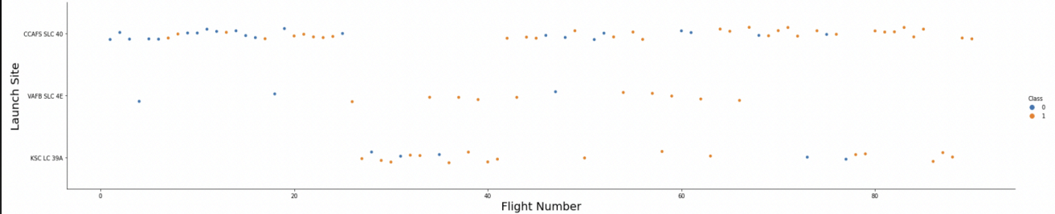
Flight Number vs. Launch Site
Key Observations
Early missions experienced more failures, while more recent launches show consistently higher success rates.
CCAFS SLC-40 accounts for approximately half of all launches.
VAFB SLC-40 and KSC LC-39A demonstrate relatively higher landing success rates.
Overall, the data suggests that launch success probability has improved over time, likely due to technological advancements and operational experience.

Slide 19
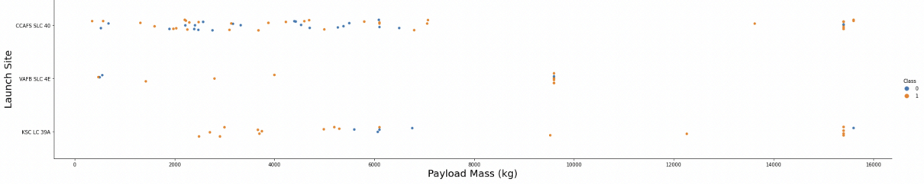
Payload vs. Launch Site
Key Observations
Across all launch sites, higher payload mass is generally associated with a higher landing success rate.
Most missions carrying payloads are above 7000 kg resulted in successful landings.
KSC LC-39A achieved a 100% success rate for missions with payload mass below 5500 kg.

Slide 20
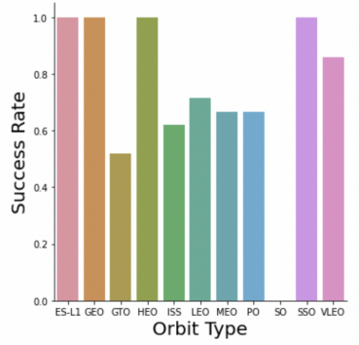
Success Rate vs. Orbit Type
Key Findings
Orbits with 100% success rate
ES-L1,GEO,HEO, and SSO
Orbits with 0% success rate
SO
Orbits with moderate success rates(50%-85%)
GTO,ISS,LEO, MEO, and PO

Slide 21
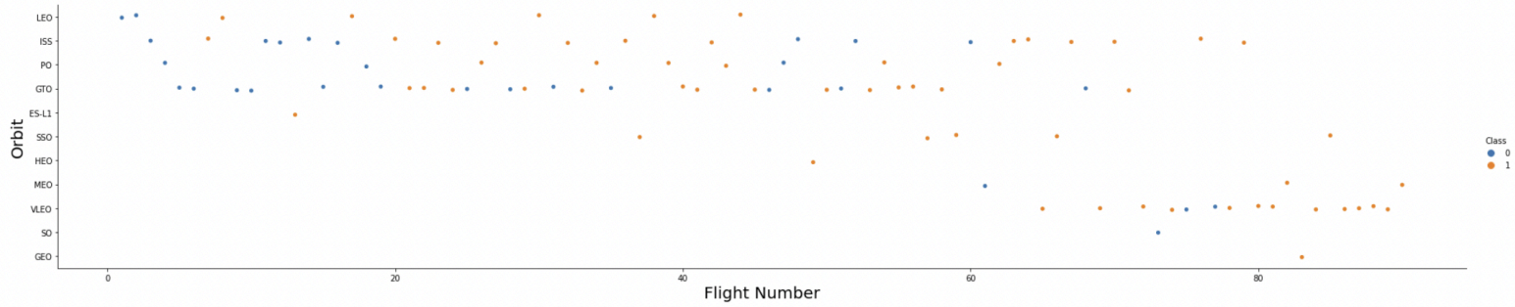
Flight Number vs. Orbit Type
Key Observations
In the LEO orbit, landing success appears to increase with the number of flights, suggesting improvement over time.
In contrast, for the GTO orbit, there is no clear relationship between flight number and landing success.

Slide 22
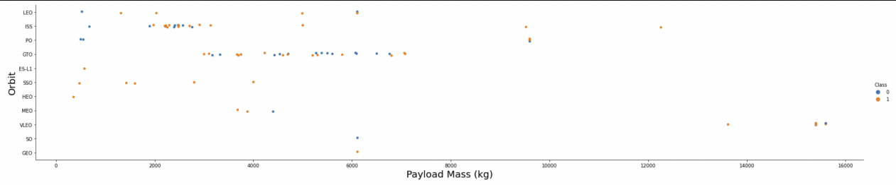
Payload vs. Orbit Type
Key Observations
Heavy payloads appear to negatively impact landing success in GTO missions.
In contrast, heavier payloads are associated with higher success rates Polar LEO(ISS) missions.

Slide 23
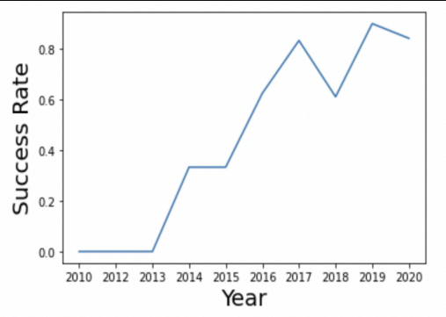
Launch Success Yearly Trend
Explanation:
The landing success rate has steadily increased from 2013 to 2020, indicating continuous improvement in SpaceX’s landing technology and operational reliability.

Slide 24
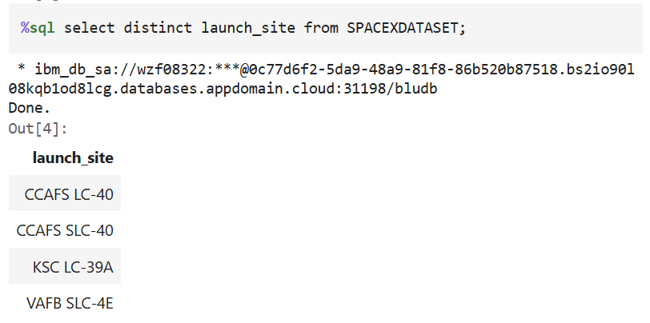
All Launch Site Names
SQL Result- Unique Launch Sites
Retrieved and displayed the names of all distinct launch sites involved in the missions.

Slide 25
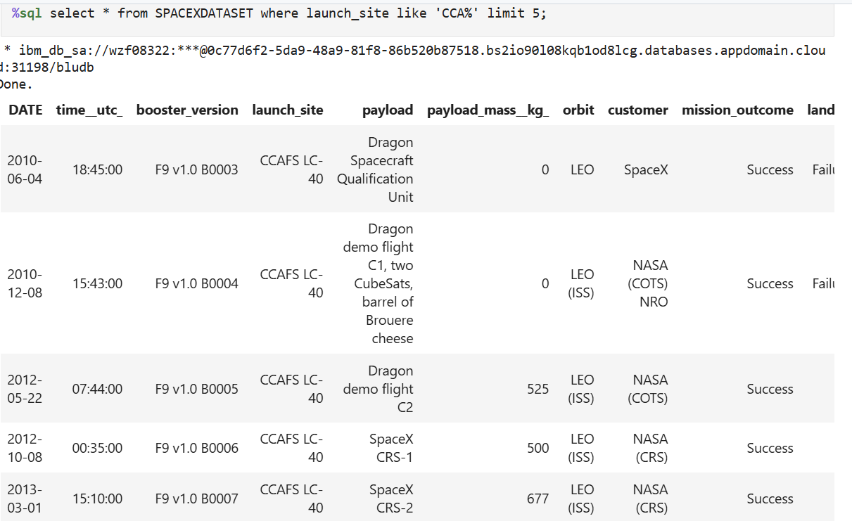
Launch Site Names Begin with 'CCA'
Explanation
Retrieved five records where the launch site name starts with “CCA” to analyze missions conducted at Cape Canaveral locations

Slide 26
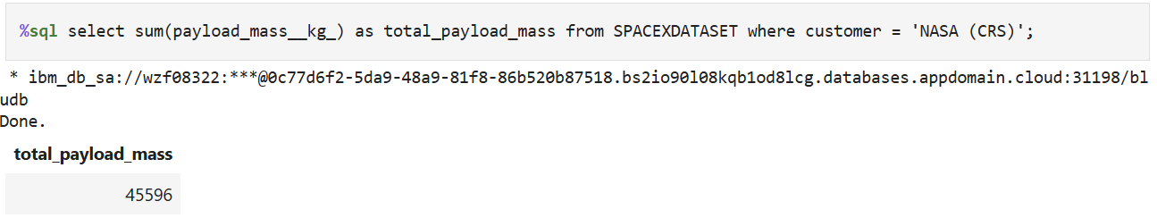
Total Payload Mass
Explanation
Calculated the total payload mass carried by boosters launched under NASA’s CRS missions.

Slide 27
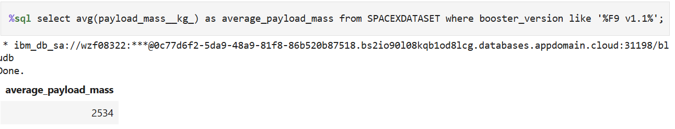
Average Payload Mass by F9 v1.1
Explanation
Calculated the average payload mass carried by the F9 v1.1 booster version

Slide 28
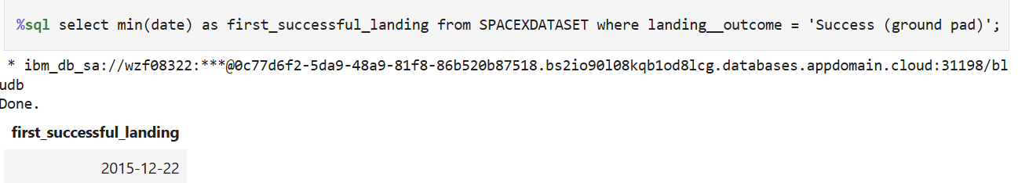
First Successful Ground Landing Date
Explanation
Identified the date of the first successful landing on a ground pad

Slide 29
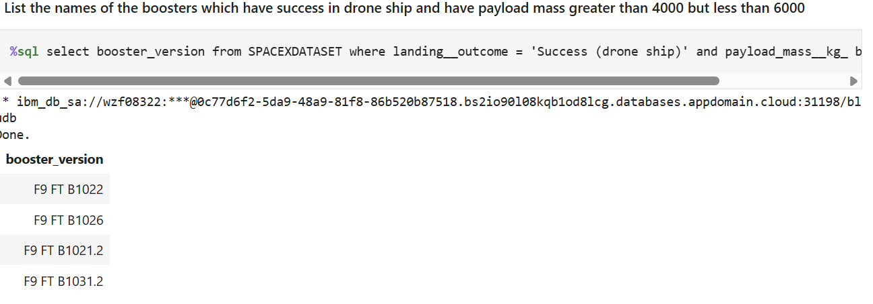
Successful Drone Ship Landing with Payload between 4000 and 6000
Explanation
Retrieved the names of boosters that successfully landed on a drone ship with payload masses between 4000 kg and 6000 kg.

Slide 30
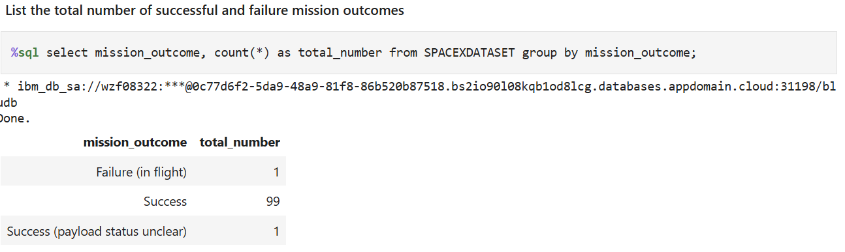
Total Number of Successful and Failure Mission Outcomes
Explanation
Calculated the total number of successful and failed mission outcomes.

Slide 31
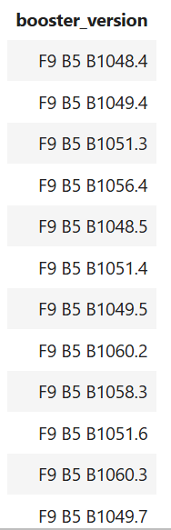
Boosters Carried Maximum Payload
Explanation
Identified the booster versions that carried the maximum payload mass.

Slide 32
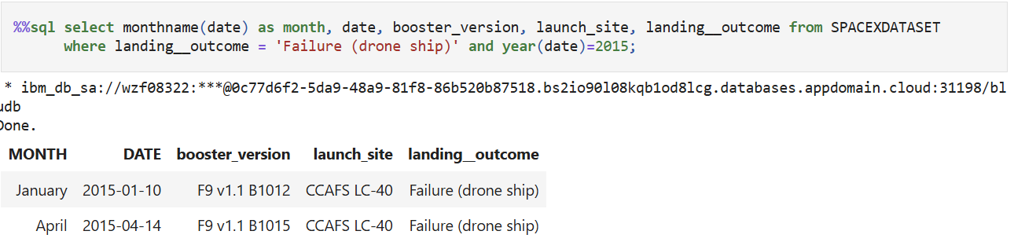
2015 Launch Records
Explanation
Retrieved failed drone ship landing outcomes in 2015, including their booster versions and corresponding launch sites.

Slide 33
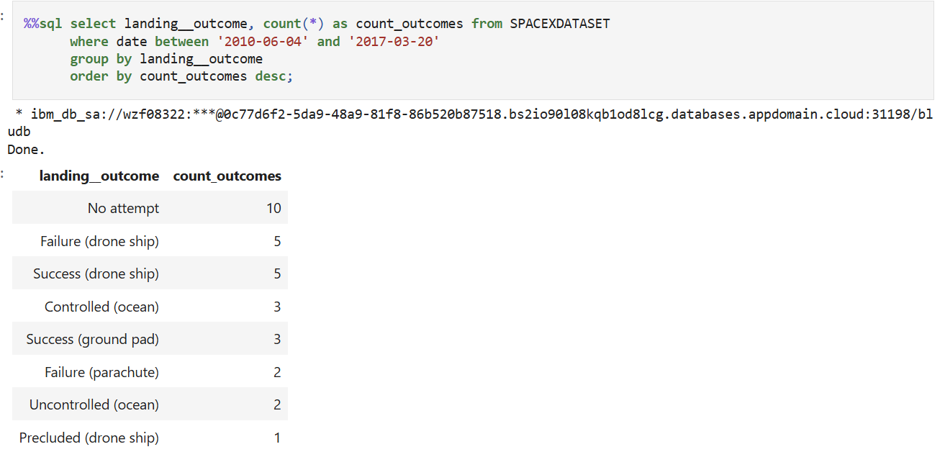
Rank Landing Outcomes Between 2010-06-04 and 2017-03-20
Explanation
Ranked the counts of landing outcomes (e.g., Failure – drone ship, Success – ground pad) between June 4, 2010 and March 20, 2017 in descending order.

Slide 34

Section 3

Slide 35
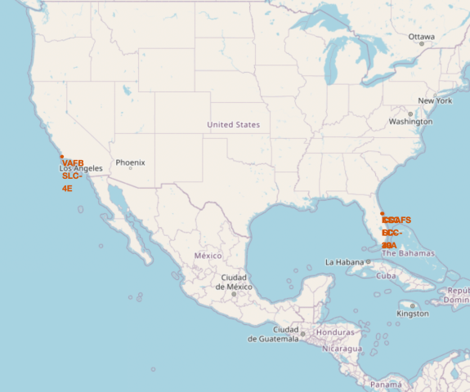
All launch sites’ location markers on a global map
Geographic Location Insights
Most launch sites are located near the Equator, where the Earth’s rotational speed is highest(approximately 1670 km/h). Launching from near the Equator provides additional velocity due to inertia, helping spacecraft reach and maintain orbit more efficiently.
All launch sites are positioned close the coastline. Launching rockets over the oceans reduces safety risks by minimizing the chance of debris falling over populated areas.

Slide 36
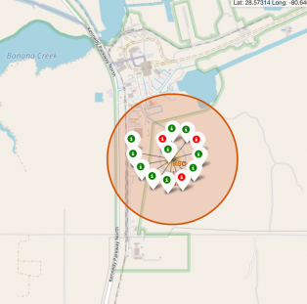
Colour-labeled launch records on the map
Launch Outcome Visualization
Color-coded markers help quickly identify launch site performance
Green markers: represent successful launches
Red markers: represent failed launches
Based on the visualization, KSC LC-39A demonstrates a notably high landing success rate compared to other launch sites.

Slide 37
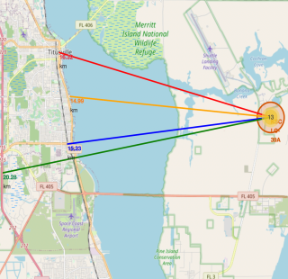
Distance from the launch site KSC LC-39A to its proximities
Proximity Analysis- KSC LC-39A
The launch site KSC LC-39A is located relatively close to key infrastructures
Railway: 15.23 km
Highway: 20.28 km
Coastline: 14.99 km
Nearest city(Titusville): 16.32 km
Given the high velocity of rockets, a failed launch could travel 15-20 km within seconds, posing potential risks to nearly populated or infrastructural areas.

Slide 38

Section 4

Slide 39
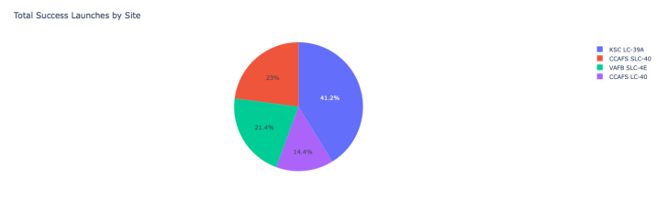
Launch success count for all sites
Dashboard Insight:
The chart clearly indicates that KSC LC-39A has the highest number of successful launches among all launch sites.

Slide 40
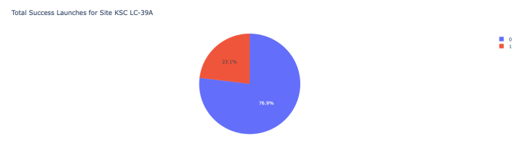
Launch site with highest launch success ratio
Launch Success Rate –KSC LC-39A
KSC LC-39A achieved the highest launch success rate at 76.9%, with 10 successful landings and only 3 failures.

Slide 41
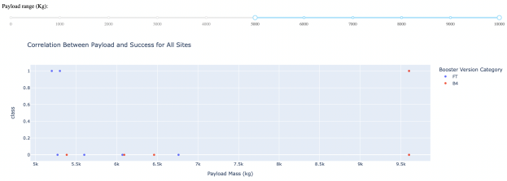
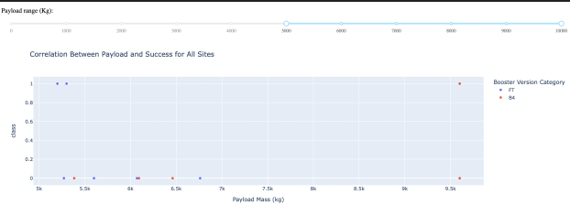
Payload Mass vs Launch Outcome for all sites
Payload Mass vs Success Rate
The charts indicate that missions carrying payloads between 2000 kg and 5500 kg have the highest landing success rate.

Slide 42

Section 5

Slide 43
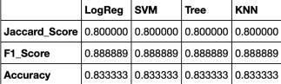
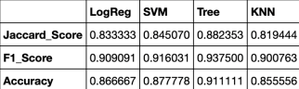
Classification Accuracy
Model Performance Evaluation
Based on the test set results, it was not possible to clearly
determine the best-performing model, as all methods achieved
similar accuracy scores.
The identical test scores may be due to the small test sample size
(18 samples). Therefore, all models were further evaluated
Using the full dataset.
The evaluation on the complete dataset indicates that the Decision
Tree model performs best, achieving the highest overall score and accuracy among all models.
Scores and Accuracy of the Test Set
Scores and Accuracy of the Entire Data Set

Slide 44
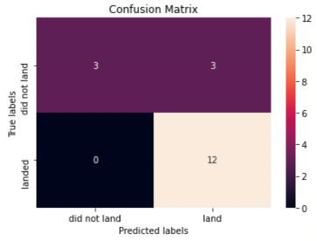
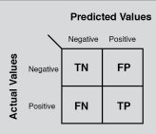
Confusion Matrix
Confusion Matrix Analysis – Logistic Regression
The confusion matrix shows that Logistic Regression is able to differentiate between successful and failed landings.
However, the primary issue observed is a relatively high number of false positives, where unsuccessful landings are incorrectly predicted as successful.

Slide 45
Conclusions
The Decision Tree model achieved the best overall performance for this dataset.
Launches with lower payload mass generally demonstrate higher landing success rates compared to heavier payloads.
Most launch sites are located near the Equator and close to the coastline, optimizing launch efficiency and safety.
The overall landing success rate has improved over time, indicating technological and operational advancements.
KSC LC-39A has the highest launch success rate among all sites.
Orbits ES-L1, GEO, HEO, and SSO show a 100% landing success rate.

Slide 46
Appendix
Special Thanks to
Instructors
Coursera
IBM

Slide 47


